Slide 1
FILTERING
It’s the process by which we can filter out certain fields from our JSON response
It can be done in 2 ways
Static
Dynamic

Slide 2
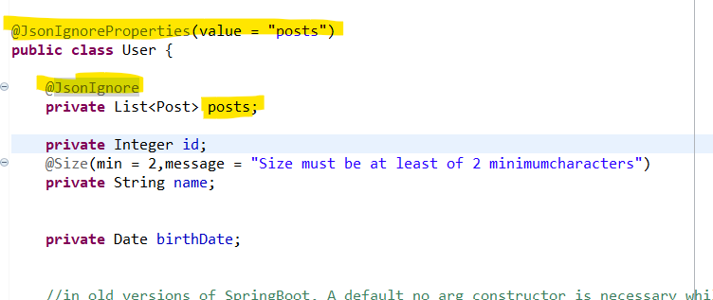
STATIC FILTERING
In Static filtering, we try to assign filters in bean itself.
This can be done by 2 different ways :
1. Using @JsonIgnore Annotaion
2.Using @JsonIgnoreProperties on the Bean class

Slide 3
Dynamic Filtering
In the dynamic filtering, we define different filters for different services, according to need. So there exists the concept of dynamic filtering.
Suppose there are three fields: name, phone, and salary. We want to send two fields: name and salary for the first service and name and phone for the second service.
But there is a limitation in dynamic filtering. We cannot configure the dynamic filtering directly in the bean. We need to start configuring filtering, where we are retrieving the values.
To implement dynamic filtering, we use a class named MappingJacksonValue. If we look at the class definition, we found the filter method definition there.

Slide 4
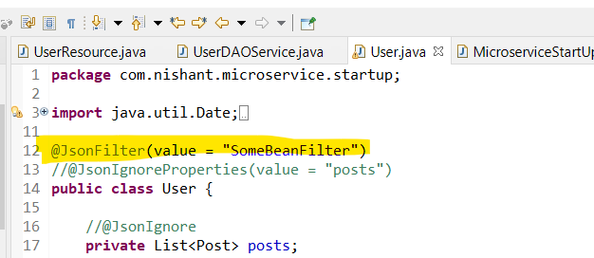
@GetMapping(path = "/DynamicFilteringExample")
public MappingJacksonValue getHelloWorldUsingDynamicFiltering() {
SimpleBeanPropertyFilter filter = SimpleBeanPropertyFilter.filterOutAllExcept("name","birthDate");
FilterProvider filters = new SimpleFilterProvider().addFilter("SomeBeanFilter", filter);
MappingJacksonValue mapping = new MappingJacksonValue(userservice.findAll());
mapping.setFilters(filters);
return mapping;
}

